Slide 1
Lab 4: Variability Due to the Measuring Instrument
As you enter room:
* Find your name on the sign in sheet.
Sign In by your Name
Find the Table you were randomly assigned.
** Sit at any of the seats and the table you were assigned.
Graded Lab 1 Reports will be returned – keep these in case of an issue with the gradebook

Slide 2
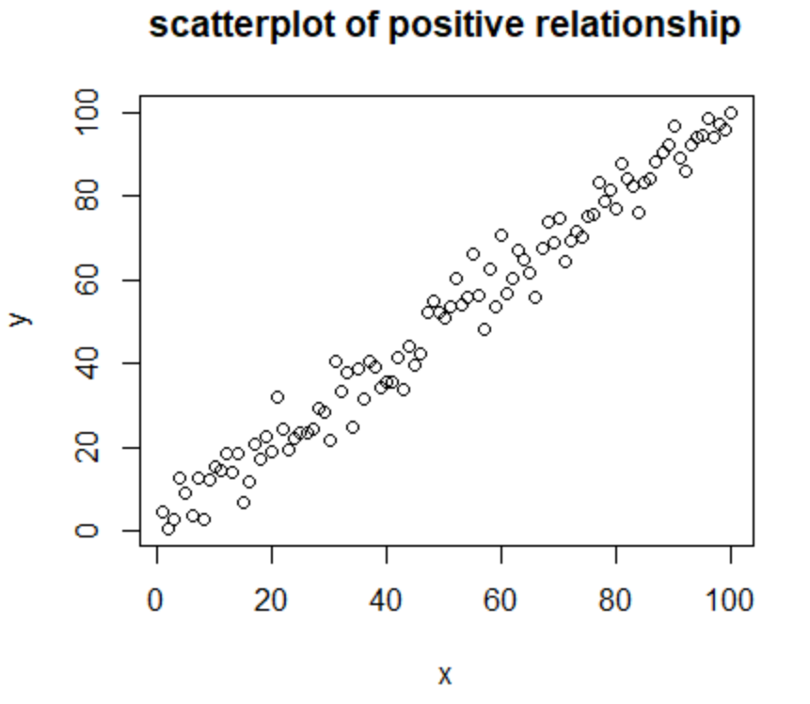
Concepts Needed for Lab 4
Relationships between two quantitative variables:
Determined by …
Looking at a scatterplot.
If as x increases, y tends to increase (the dots are rising as you read left to right) there is a positive relationship.
If as x increases, y tends to decrease (the dots are falling as you read left to right) there is a negative relationship.
Closer the dots fall to a given pattern, most common is a linear / line pattern, the stronger the relationship.
Calculating a correlation coefficient, r.
If r is negative then there is a negative relationship.
If r is positive then there is a positive relationship.
The closer the value is to -1 or +1 the stronger the linear (line) pattern.

Slide 3
Concepts Needed for Lab 4
Regression:
If two variables have a relatively strong relationship a statistical model can be created to predict new values of the response variable using the predictor variable.
In other words, we can determine the mathematical equation that shows the pattern in the data.
If the pattern is linear then we can use the following information to generate the equation (model): response variable = slope (predictor variable) + y-intercept -OR- y = mx + b.
The y-intercept and slope of the line that best fits the data will be determined by StatCrunch.
If the pattern is curved then we can use the following information to generate the equation (model): note this was not covered in lecture. Response variable = y-intercept + coefficient1 (predictor variable) + coefficient2(predictor variable)^2.
The equations will be calculated using software to determine the equation that limits the distances between the predicted value and the true value.

Slide 4
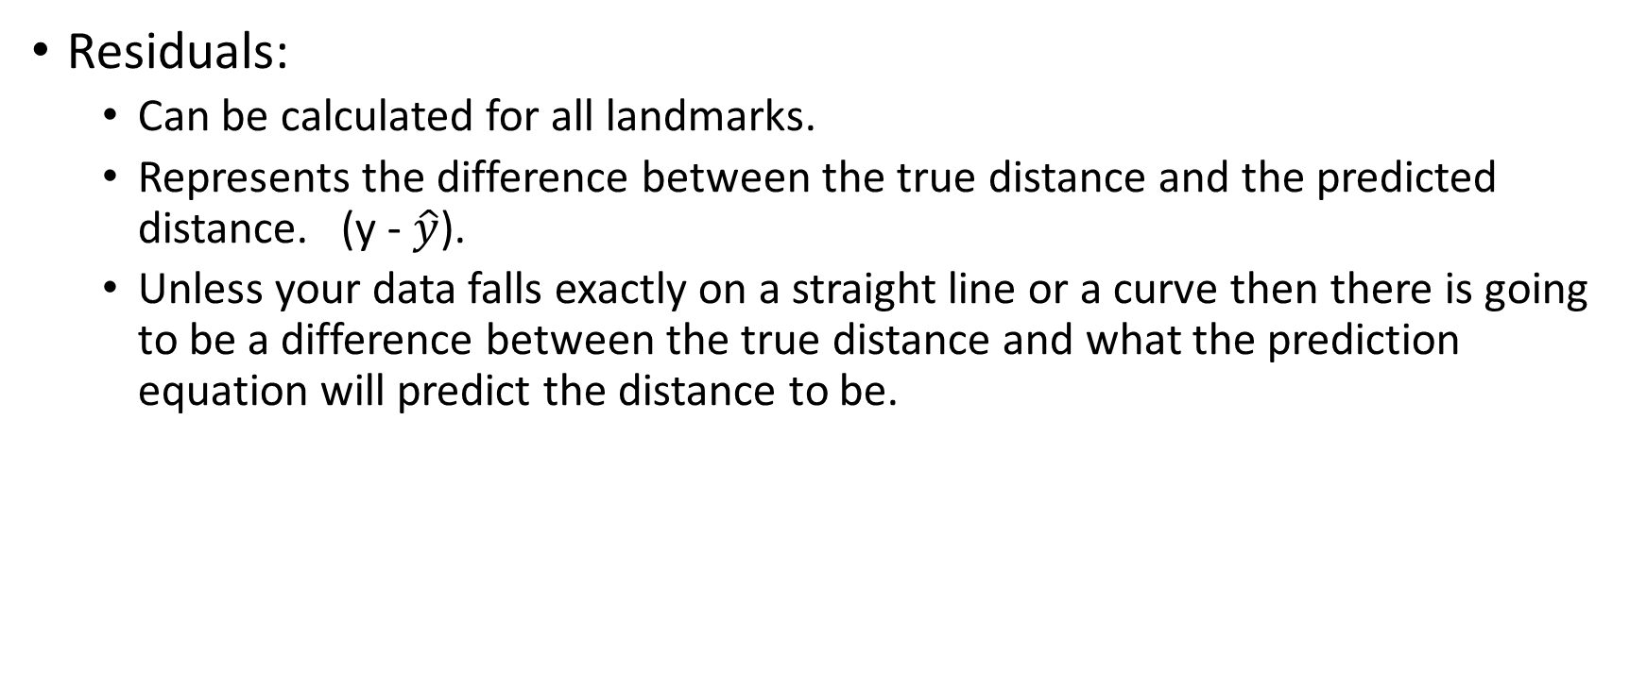
Concepts Needed for Lab 4
Residuals:
Can be calculated for all landmarks.
Represents the difference between the true distance and the predicted distance. (y - $\hat{y}$).
Unless your data falls exactly on a straight line or a curve then there is going to be a difference between the true distance and what the prediction equation will predict the distance to be.

Slide 5
Materials Needed for This Lab
Each table should have the following:
A list of the descriptions of the objects to be guested outside on the horseshoe (students should use this to fill in Column 2, Object Description, on table 4.1 page 29.)
A list of a few objects all members at this table must find the true distance to on the horseshoe. (students should use this to fill in some of the cells in column 5, Your Team’s Measured Distance (ft), on table 4.1 page 29.).
A survey wheel.

Slide 6
Data Collection for Lab 4
We will go outside to the horseshoe and guess the distance from a reference point to 11 different landmarks. Lab instructors will tell you the landmarks to use.
Take all the following outside with you (everything else you can leave in the room the door will be closed and locked):
Your lab book (to fill in table 4.1 on page 29).
The survey wheel. (one per table).
The objects your lab group were assigned to measure the distance to using the survey wheel. (one set per table but someone needs to take it).
Each student will collect their own data. Everyone must take their lab books outside and everyone must write down a guess to each landmark. Don’t leave the horseshoe without having column 3, Guessed Distance (ft), completely filled in on page 29.
Each lab table was assigned a few landmarks to measure the distance to. After all guesses are done (the lab instructors will lead this), each labs will measure the distance from the reference point to the assigned landmark, these are written in the 5thcolumn of table 4.1.

Slide 7
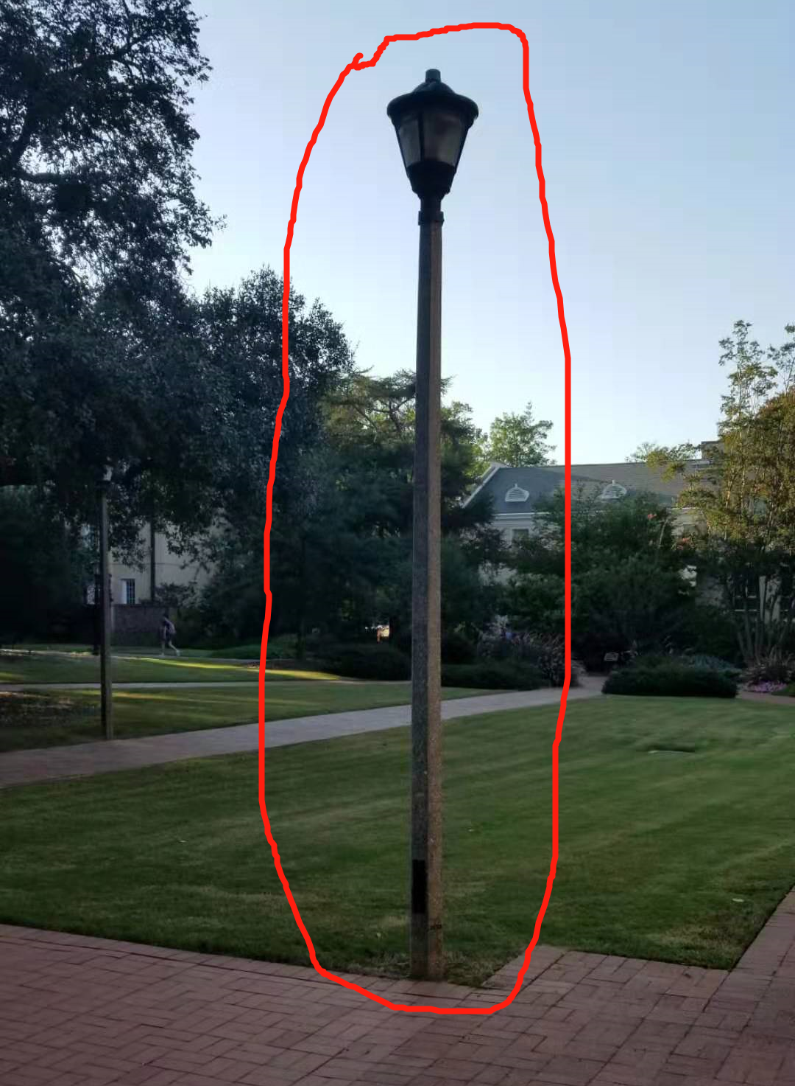
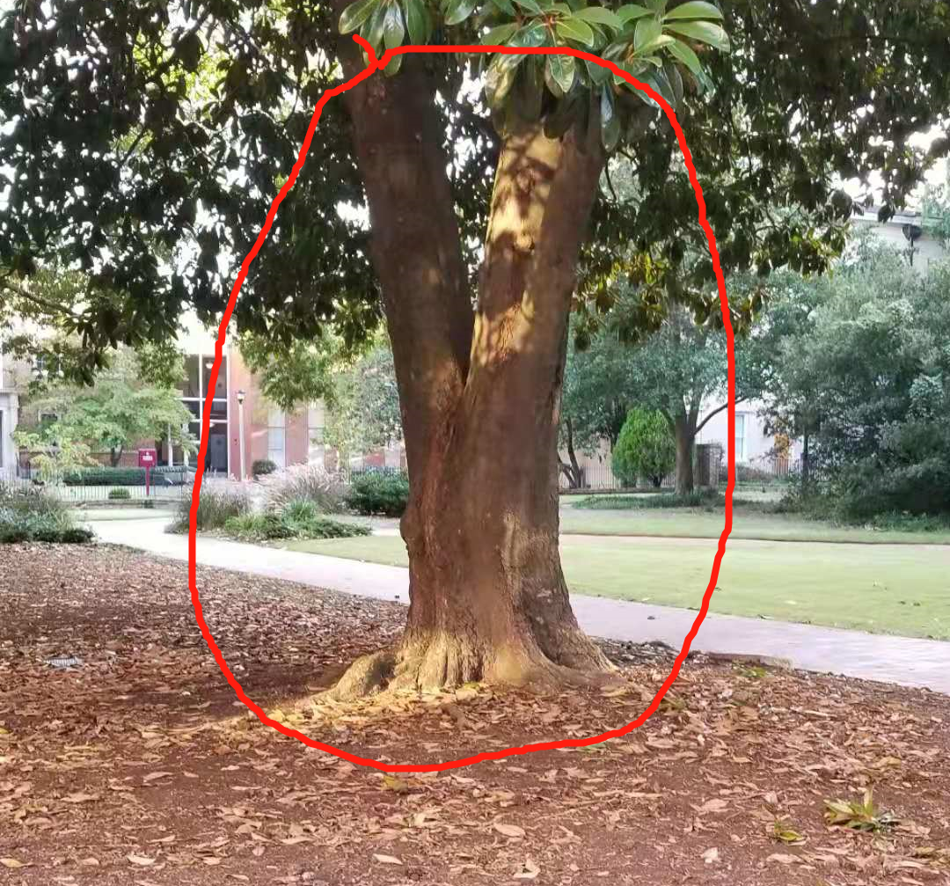
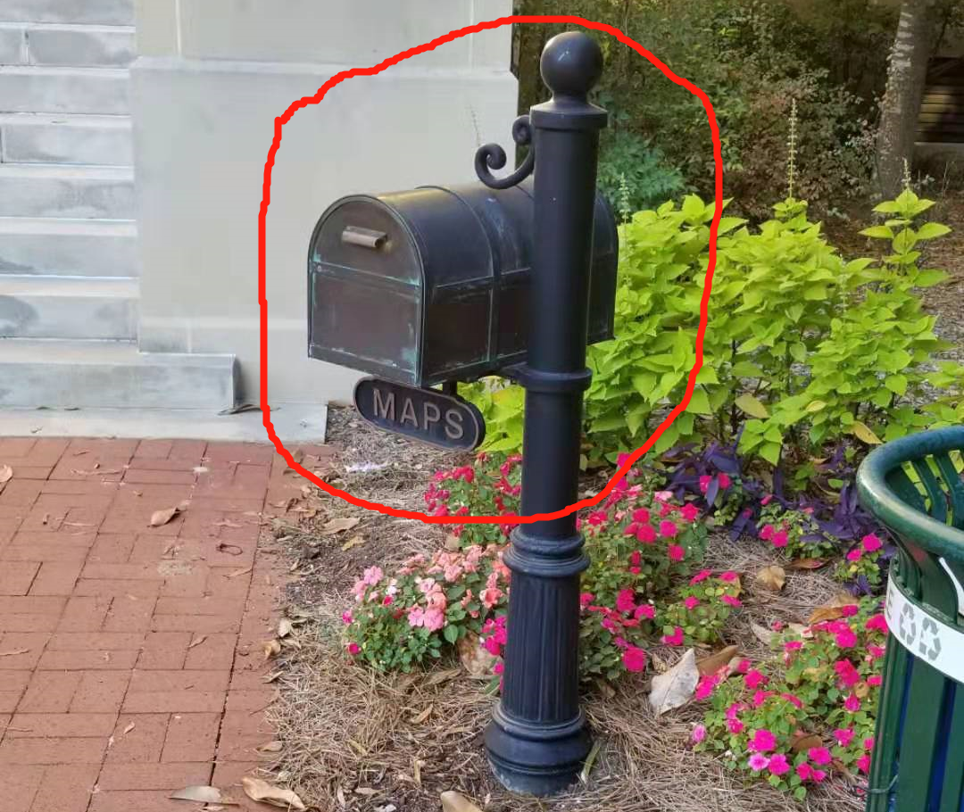
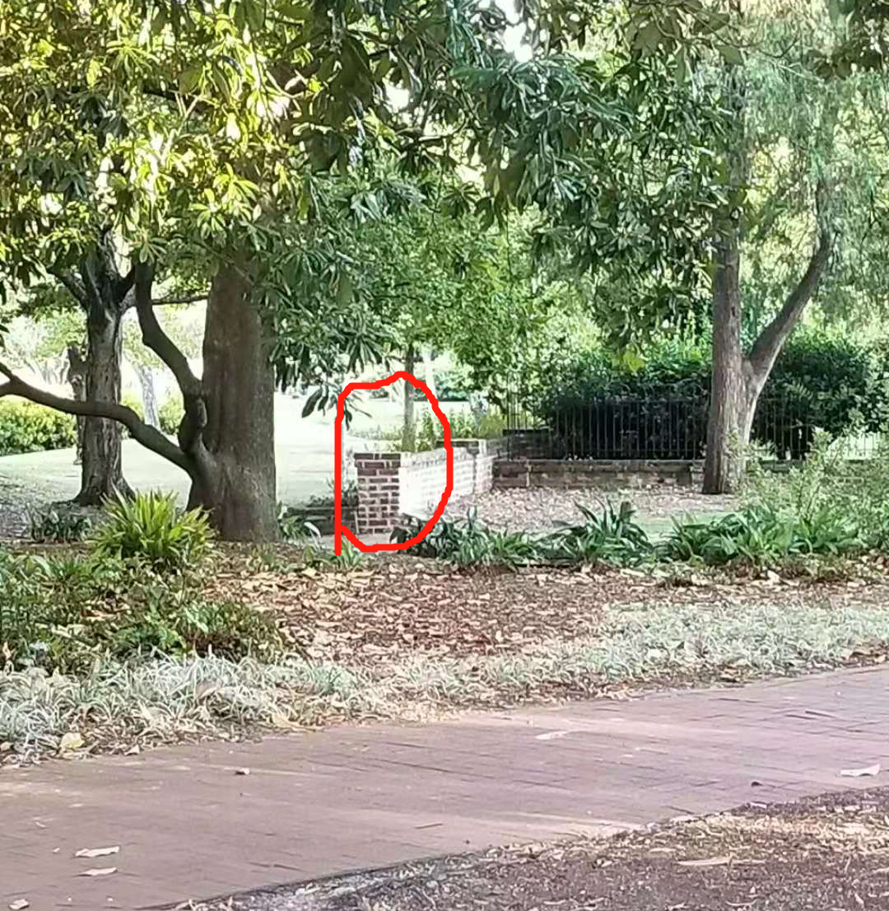
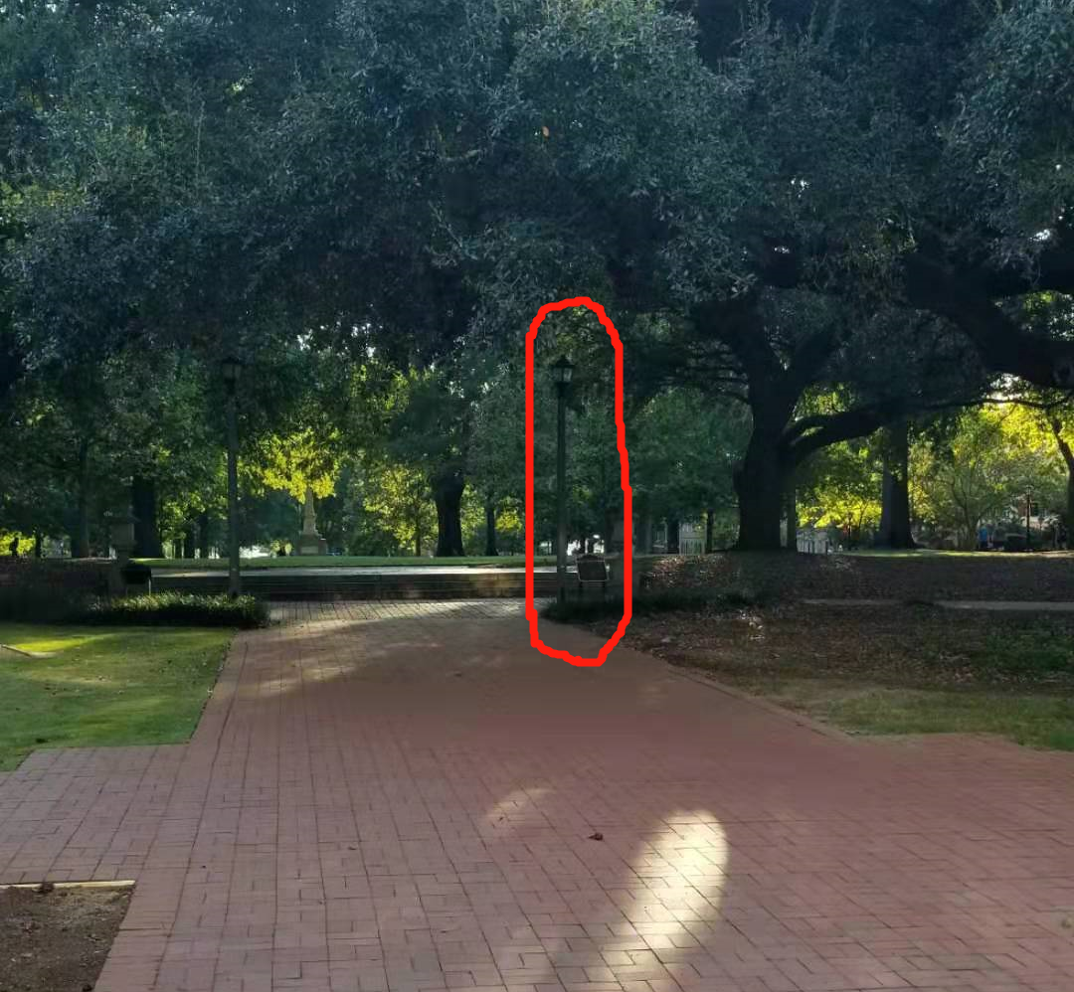
3
2
1 Distance to Maps Box
2 Base of Closest Magnolia Tree
3 Lamp Post across sidewalk
4 Lamp Post on Right at the end of sidewalk leading to horseshoe
5 Base of Brick Wall
1
4
5

Slide 8
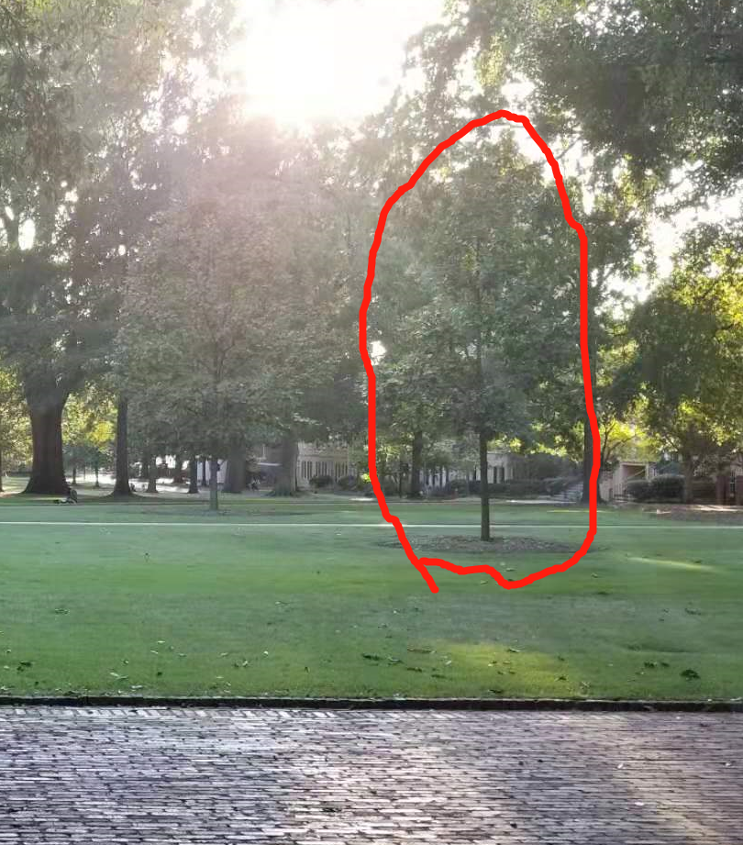
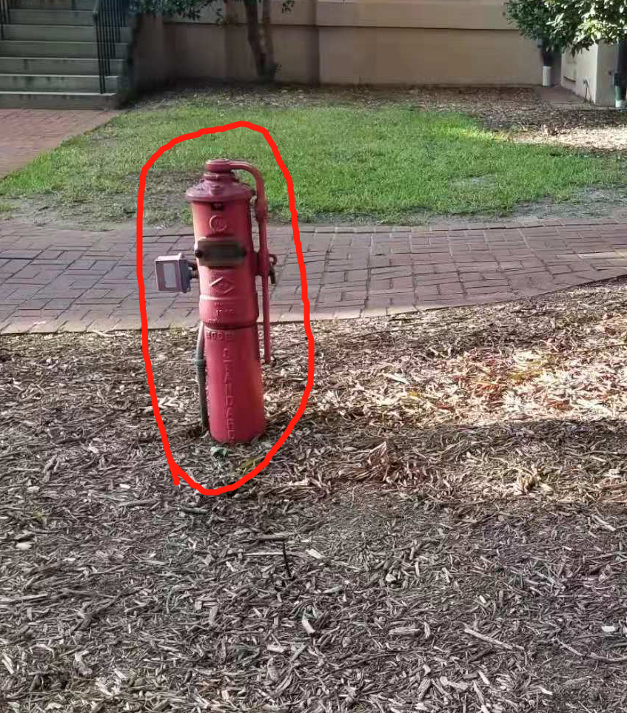
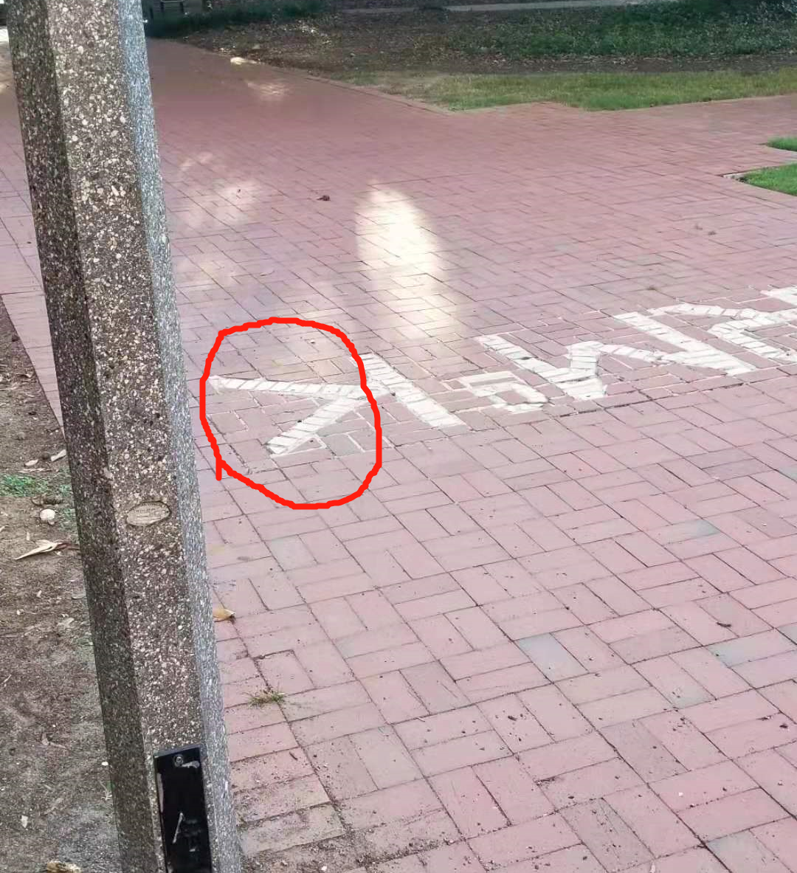
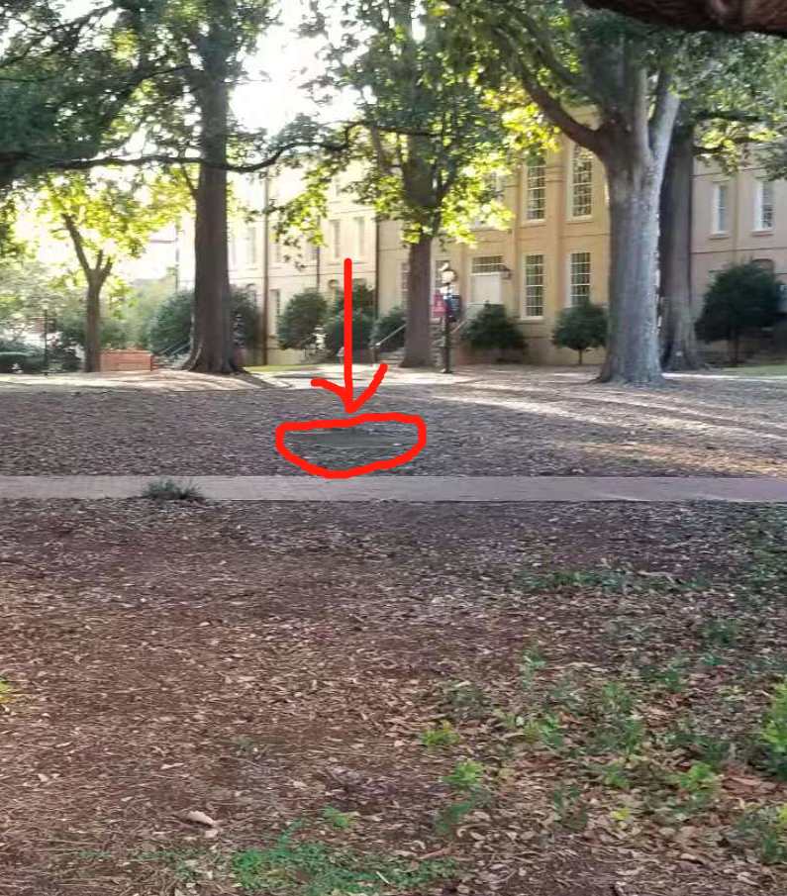
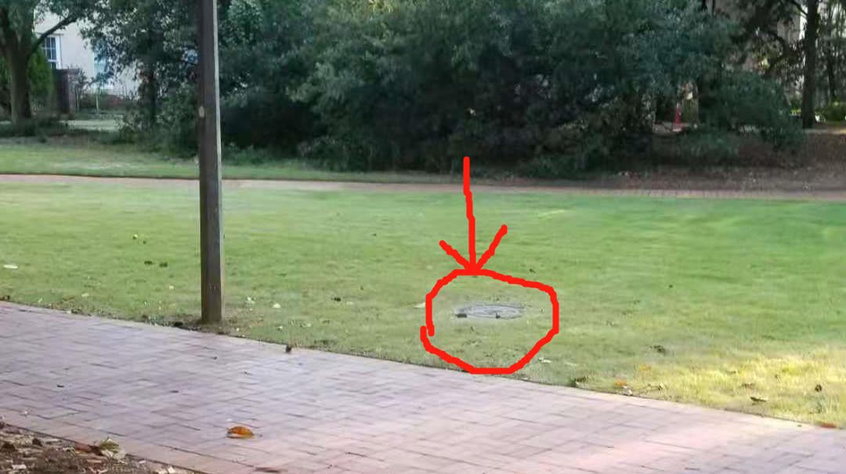
6
7
9
10
6 Red fire hydrant to right
7 Shortest distance to letters on Sidewalk
8 Nearest point to manhole cover to left.
9 Closest corner to concrete square to right.
10 Facing statue first tree past oval walkway.
8

Slide 9
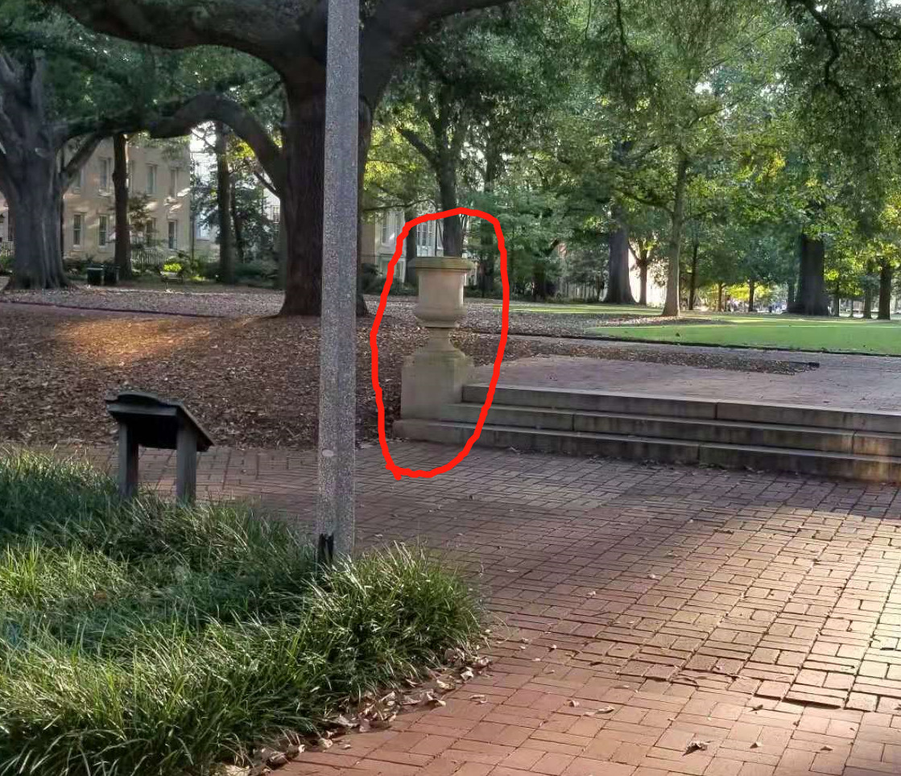
11 Left most urn.

Slide 10
Data Collection for Lab 4
The following are done after everyone is back in the lab room.
Provide the lab instructor with your lab group’s distances measured.
The lab instructor will lead the class in determining the True Distance.
We will use the median of the 3 different measured distances.
Fill in the 6th column, True Distance (Median Measured Distance (ft)), in Table 4.1 on page 29. Everyone will have the same values here.
Think about why we might want to use the median as the true distance (See question #1 on page 30).
At this point everyone should have their Guessed Distances (these will be our predictor variable, x) and the True Distances (these will be our response variables, y).

Slide 11
Data Analysis for Lab 4
Each student will do their own analysis on their individual data (using their own guesses).
Go to StatCrunch.com and open a spreadsheet.
Create a column with the guessed distances and another column with the true distances (note that if you are sharing a computer there will be two different guessed distances columns – label them with names to eliminate confusion).
DO NOT enter your guess for the 11th object.
All measurements are to be in feet (you can simply round to the nearest foot).

Slide 12
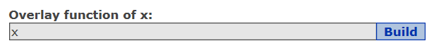
Data Analysis for Lab 4
1st Set of Output to Generate:
Create a scatterplot with superimposed line:
GRAPHs -> Scatterplot -> x variable is Guessed Distances and y variable is True Distances.
Overlay function of x: type x
This adds a line representing the line y = x.
Note that this line is not the line of best fit. This line represents where the data would have fallen if you were a perfect guesser.
Copy this scatterplot with the superimposed line y = x to a Word document.
Questions #2 and #3 are answered based on this output.

Slide 13
Data Analysis for Lab 4
2nd set of output – Simple Linear Regression analysis.
Stat -> Regression -> Simple Linear -> x = guessed distances and y = true distances.
Place a copy of the output generated (both screens) into Word. Copy all output provided.
Fill in first row of table 4.2 on page 30 using this output.
s is called “estimate of error standard deviation”
3rd set of output – Quadratic Regression analysis.
Stat -> Regression -> Polynomial-> x = guessed distances and y = true distances.
Place a copy of the output generated (both screens) into Word. Copy all output provided.
Fill in second row of table 4.2 on page 30 using this output.
s is called “ROOT MSE”

Slide 14
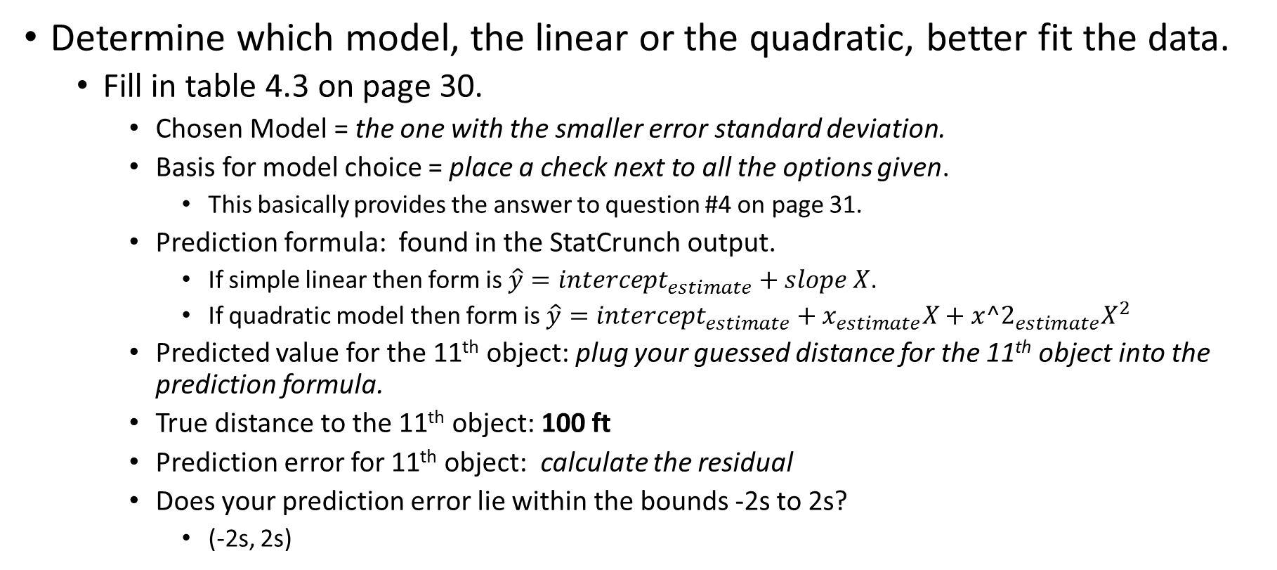
Data Analysis for Lab 4
Determine which model, the linear or the quadratic, better fit the data.
Fill in table 4.3 on page 30.
Chosen Model = the one with the smaller error standard deviation.
Basis for model choice = place a check next to all the options given.
This basically provides the answer to question #4 on page 31.
Prediction formula: found in the StatCrunch output.
If simple linear then form is $\hat{y}=intercept_{estimate}+slope X$.
If quadratic model then form is $\hat{y}=intercept_{estimate}+x_{estimate}X+x{^2}_{estimate}X^{2}$
Predicted value for the 11th object: plug your guessed distance for the 11th object into the prediction formula.
True distance to the 11th object: 100 ft
Prediction error for 11th object: calculate the residual
Does your prediction error lie within the bounds -2s to 2s?
(-2s, 2s)

Slide 15
Before you Leave
Turn in pages 29-31 from the lab book. Everyone needs to turn in their own work.
Make sure columns 3 and 6 are filled in on table 4.1 page 29.
Make sure all parts of tables 4.2 and 4.3 are completely filled in on page 30.
Make sure you answer all questions completely.
Help with #5
Reality Check question is in reference to the Reality Check box on page 28.

